Slide 1
18-349: Introduction to Embedded Real-Time Systems
Lecture 6: Timers and Interrupts
Anthony Rowe
Electrical and Computer Engineering
Carnegie Mellon University

Slide 2
Lecture Overview
Timers
Interrupts
Interrupt Latency
Interrupt Handlers
Concurrency issues with interrupt handlers

Slide 3
What is a Timer?
A device that uses a high­speed clock input to provide a series of time or count-related events
Counter Register
System Clock
0x1206
Reload on Zero
÷
000000
Clock Divider
Countdown Register
Interrupt to Processor
I/O Control

Slide 4

Uses of Timers
Pause Function
Suspends task for a specified amount of time
One-shot timer
Single one-time-only timeout
Periodic timer
Multiple renewable timeouts
Time-slicing
Chunks of time to each task
Watchdog timer

Slide 5
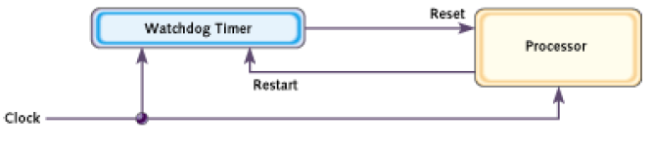
Watchdog Timers
A piece of hardware that can be used to reset the processor in case of anomalies
Typically a timer that counts to zero
Reboots the system if counter reaches zero
For normal operation – the software has to ensure that the counter never reaches zero (“kicking the dog”)

Slide 6
Care of Your Watchdog
A watchdog can get the system out of many dangerous situations
But, be very careful
Bugs in the watchdog timer could perform unnecessary resets
Bugs in the application code could perform resets
Choosing the right kicking interval is important
System initialization process is usually lengthy
Some watchdogs can wait longer for the first kick than for the subsequent kicks
What should you do, for example, if some functions in a for loop can take longer than the maximum timer interval?

Slide 7
Interrupts
Merriam-Webster:
“to break the uniformity or continuity of”
Informs a program of some external events
Breaks execution flow
Key questions:
Where do interrupts come from?
How do we save state for later continuation?
How can we ignore interrupts?
How can we prioritize interrupts?
How can we share interrupts?

Slide 8
Interrupts
Interrupt (a.k.a. exception or trap):
An event that causes the CPU to stop executing current program
Begin executing a special piece of code
Called an interrupt handler or interrupt service routine (ISR)
Typically, the ISR does some work
Then resumes the interrupted program
Interrupts are really glorified procedure calls, except that they:
can occur between any two instructions
are “transparent” to the running program (usually)
are not explicitly requested by the program (typically)
call a procedure at an address determined by the type of interrupt, not the program

Slide 9
Two basic types of interrupts (1/2)
Those caused by an instruction
Examples:
TLB miss
Illegal/unimplemented instruction
div by 0
SVC (supervisor call, e.g.: SVC #3)
Names:
Trap, exception

Slide 10
Two basic types of interrupts (2/2)
Those caused by the external world
External device
Reset button
Timer expires
Power failure
System error
Names:
interrupt, external interrupt

Slide 11
How it works
Something tells the processor core there is an interrupt
Core transfers control to code that needs to be executed
Said code “returns” to old program
Much harder then it looks.
Why?

Slide 12
Devil is in the details
How do you figure out where to branch to?
How to you ensure that you can get back to where you started?
Don’t we have a pipeline? What about partially executed instructions?
What if we get an interrupt while we are processing our interrupt?
What if we are in a “critical section?”

Slide 13
Interrupt vs. Polled I/O
Polled I/O requires the CPU to ask a device (e.g. Ethernet controller) if the device requires servicing
For example, if the Ethernet controller has changed status or received packets
Software plans for polling the devices and is written to know when a device will be serviced
Interrupt I/O allows the device to interrupt the processor, announcing that the device requires attention
This allows the CPU to ignore devices unless they request servicing (via interrupts)
Software cannot plan for an interrupt because interrupts can happen at any time ­­ therefore, software has no idea when an interrupt will occur
Processors can be programmed to ignore or mask interrupts
Different types of interrupts can be masked (IRQ vs. FIQ)

Slide 14
Polling vs. Interrupt­Driven I/O
Polling requires code to loop until device is ready
Consumes lots of CPU cycles
Can provide quick response (guaranteed delay)
Interrupts don't require code to loop until the device is ready
Device interrupts processor when it needs attention
Code can go off and do other things
Interrupts can happen at any time
Requires careful coding to make sure other programs (or your own) don't get messed up
What do you think real-time embedded systems use?

Slide 15
Onto IRQs & FIQs: Interrupt Handlers
time
user program
user program
Task
IRQ
IRQ Interrupt handler
FIQ
On interrupt, the processor will set the corresponding interrupt bit in the cpsr to disable subsequent interrupts of the same type from occurring.
However, interrupts of a higher priority can still occur.
Interrupt

Slide 16
Timing Issues in Interrupts
Before an interrupt handler can do anything, it must save away the current program's registers (if it touches those registers)
That's why the FIQ has lots of extra registers, to minimize CPU context-saving overhead
time
user program
CPU context saved
user program
Task
IRQ
“servicing” interrupt
FIQ
CPU context restored
Interrupt
Interrupt latency

Slide 17
Servicing FIQs Within IRQ
Interrupts can occur within interrupt handlers
time
user program
user program
Task
IRQ
IRQ Interrupt handler
FIQ
FIQ Interrupt handler
Interrupt
Second
Interrupt

Slide 18
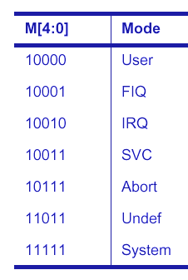
cpsr & spsr for IRQs and FIQs
31
28
8
4
0
N
Z
C
V
I F
Mode
Interrupt Disable bits
I = 1, disables the IRQ
F = 1, disables the FIQ
Mode bits
Processor mode differs

Slide 19
Exception Priorities
Exceptions | Priority | I bit (1aIRQ Disabled) | F bit (1aFIQ Disabled)
Reset | 1 (highest) | 1 | 1
Data Abort | 2 | 1
Fast Interrupt Request (FIQ) | 3 | 1 | 1
Interrupt Request (IRQ) | 4 | 1
Prefetch Abort | 5 | 1
Software Interrupt | 6 | 1
Undefined Instruction | 6 (lowest) | 1

Slide 20
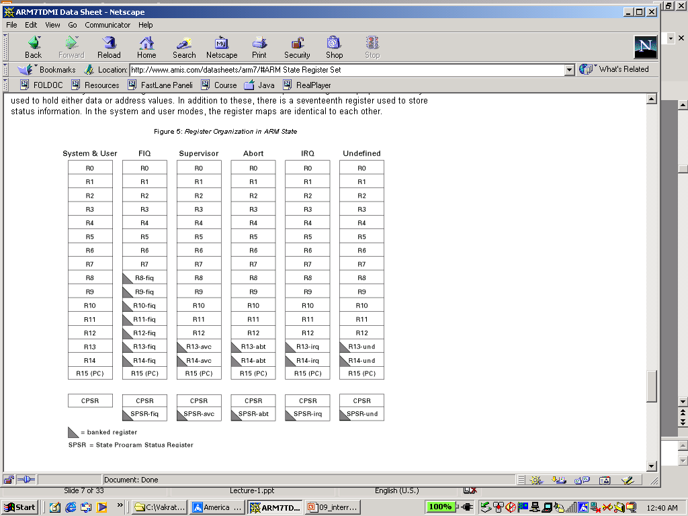
How are FIQs Faster?
User
FIQ
IRQ
FIQs are faster than IRQs in terms of interrupt latency
FIQ mode has five extra registers at its disposal
No need to save registers r8 – r12
These registers are banked in FIQ mode
Convenient to store status between calls to the handler
FIQ vector is the last entry in the vector table
The FIQ handler can be placed directly at the vector location and run sequentially starting from that location
Cache-based systems: Vector table + FIQ handler all locked down into one block

Slide 21
IRQ and FIQ ISR Handling
IRQ Handling
FIQ Handling
When an IRQ occurs, the processor
Copies cpsr into spsr_irq
Sets appropriate cpsr bits
Sets mode field bits to 10010
Disables further IRQs
Maps in appropriate banked registers
Stores the address of “next instruction + 4” in lr_irq
Sets pc to vector address 0x00000018
When an FIQ occurs, the processor
- Copies cpsr into spsr_fiq
- Sets appropriate cpsr bits
Sets mode field bits to 10001
Disables further IRQs and FIQs
- Maps in appropriate banked registers
- Stores the “next instruction + 4” in lr_fiq
- Sets pc to vector address 0x0000001c0
To return, exception handler needs to:
Restore cpsr from spsr_irq
Restore pc from lr_irq
Return to user mode
To return, exception handler needs to:
- Restore cpsr from spsr_fiq
- Restore pc from lr_fiq
- Return to user mode

Slide 22
Interrupt Controller
IRQ
Timers
Interrupt
Controller
Serial Port
FIQ
SPI
ARM
Notes:
22
© Rajeev Gandhi, 2010

Slide 23
Jumping to the Interrupt Handler
Non-vectored
Processor jumps to the same location irrespective of the kind of interrupt
Hardware simplification
Vectored
Device supplies processor with address of interrupt service routine
Interrupt handler reads the address of the interrupt service routine from a special bus
Why the different methods?
If multiple devices uses the same interrupt the processor must poll each device to determine which device interrupted the processor
This can be time-consuming if there is a lot of devices
In a vectored system, the processor would just take the address from the device (which dumps the interrupt vector onto a special bus).

Slide 24
Jumping to the Interrupt Handler
Auto-vectored
Multiple CPU interrupt inputs for interrupts of different priority level
ARM has two – FIQ and IRQ
Other processors, like 68000, SPARC, may have 8 or more
Processor-determines address of interrupt service routine based on type of interrupt
For ARM, pseudo-auto vectored IRQs and FIQs is implemented using an on-chip interrupt controller

Slide 25
Types of Interrupt Handlers
Non-nested interrupt handler (simplest possible)
Services individual interrupts sequentially, one interrupt at a time
Nested interrupt handler
Handles multiple interrupts without priority assignment
Prioritized (re-entrant) interrupt handler
Handles multiple interrupts that can be prioritized
Notes:
25

Slide 26
Non-Nested Interrupt Handler
Does not handle any further interrupts until the current interrupt is serviced and control returns to the interrupted task
Not suitable for embedded systems where interrupts have varying priorities and where interrupt latency matters
However, relatively easy to implement and debug
Inside the ISR (after the processor has disabled interrupts, copied cpsr into spsr_mode, set the etc.)
Save context – subset of the current processor mode’s nonbanked registers
Not necessary to save the spsr_mode – why?
ISR identifies the external interrupt source – how?
Service the interrupt source and reset the interrupt
Restore context
Restore cpsr and pc
Notes:
26
Not necessary to save the spsr in a non-nested interrupt handler because it is not going to be corrupted by any subsequent interrupt (we only handle one interrupt at a time)
External interrupt source is identified through the interrupt status register – the interrupt status register is examined to see which external device has asserted the interrupt and requires servicing

Slide 27
Nested Interrupt Handler
Allows for another interrupt to occur within the currently executing handler
By re-enabling interrupts at a safe point before ISR finishes servicing the current interrupt
Care needs to be taken in the implementation
Protect context saving/restoration from interruption
Check stack
Increases code complexity, but improves interrupt latency
Does not distinguish between high and low priority interrupts
Time taken to service an interrupt can be high for high-priority interrupts
Notes:
27

Slide 28
Prioritized (Re-entrant) Interrupt Handler
Allows for higher-priority interrupts to occur within the currently executing handler
By re-enabling higher-priority interrupts within the handler
By disabling all interrupts of lower priority within the handler
Same care needs to be taken in the implementation
Protect context saving/restoration from interruption, check stack overflow
Does distinguish between high and low priority interrupts
Interrupt latency can be better for high-priority interrupts
Notes:
28

Slide 29
Interrupts and Stacks
Stacks are important in interrupt handling
Especially in handling nested interrupts
Who sets up the IRQ and FIQ stacks and when?
Stack size depends on the type of ISR
Nested ISRs require more memory space
Stack grows in size with the number of nested interrupts
Good stack design avoids stack overflow (where stack extends beyond its allocated memory) – two common methods
Memory protection
Call stack-check function at the start of each routine
Important in embedded systems to know the stack size ahead of time (as a part of the designing the application) – why?
Notes:
29
The reset ISR (boot-up firmware) sets up all of the stacks for all of the modes, as a part of the initialization code for the system. This is done before interrupts are enabled.
Important to know the stack size ahead of time in embedded systems because the stacks are set up during init time and the stack size is typically reserved at boot-up time by the firmware.

Slide 30
Resource Sharing Across Interrupts
Interrupts can occur asynchronously
Access to shared resources and global variables must be handled in a way that does not corrupt the program
Normally done by masking interrupts before accessing shared data and unmasking interrupts (if needed) afterwards
Clearly, when interrupt-masking occurs, interrupt latency will be higher
Up next – start with a simple keyboard ISR and then understand
What can happen when the ISR takes a while to execute
How do we improve its interrupt latency
What can go wrong
Notes:
30

Slide 31
Starting With a Simple Example
Keyboard command processing
The “B” key is pressed by the user
The “keyboard” interrupts the processor
Jump to keyboard ISR (non-nested)
keyboard_ISR() {
ch <­ Read keyboard input register
switch (ch) {
case ‘b’ : startApp(); break;
case ‘x’ : doSomeProcessing(); break;
...
}
}
What happens if another key is pressed ­ or if a timer interrupt occurs?
How long does this processing take?
return from ISR
Notes:
31

Slide 32
Improving Interrupt Latency
Add a buffer (in software or hardware) for input characters.
This decouples the time for processing from the time between keystrokes, and provides a computable upper bound on the time required to service a keyboard interrupt
Commands stored in the input_buffer can be processed in the user/application code
Stores the input and then quickly returns to the “main program” (process)
A key is pressed by the user
The “keyboard” interrupts the processor
Jump to keyboard ISR
keyboard_ISR() {
*input_buffer++ = ch;
...
}
…
…
while (!quit){
if (*input_buffer){
processCommand(*input_buffer);
removeCommand(input_buffer);
}
}
…
Application Code
return from ISR
Notes:
32

Slide 33
What Can Go Wrong? Buffer Processing
keyboard_ISR(){
ch <­ Read ACIA input register
*input_buffer++ = ch;
}
return from ISR
application code
…
while (!quit){
if (*input_buffer){
processCommand(*input_buffer);
removeCommand(input_buffer);
}
}
…
What happens if another command is entered as you remove one from the inputBuffer?
Notes:
33

Slide 34
Another Concurrency Problem
An application uses the serial port to print characters on the terminal emulator (Hyper Terminal)
The application calls a function PrintStr to print characters to the terminal
In the function PrintStr, the characters to be printed are copied into an output buffer (use of output buffer to reduce interrupt latency)
In the serial port ISR
See if there is any data to be printed (whether there are new characters in the output buffer)
Copy data from the output buffer to the transmit holding register of the UART
The (new app) display also needs to print the current time on the terminal – a timer is used (in interrupt mode) to keep track of time
In the timer ISR
Compute current time
Call PrintStr to print current time on the terminal emulator
Notes:
34

Slide 35
Another Example: Buffer for Printing Chars to Screen
PrintStr(*string)
char *string;
{
while (*string) {
outputBuffer[tail++] = *string++;
}
}
PrintStr(“this is a line”);
T H I S I S
tail points here ­ and a timer interrupt occurs
Jump to timer_ISR
timer_ISR(){
clockTicks++;
PrintStr(convert(clockTicks));
}
T H I S I S 2 : 3 0
Notes:
35

Slide 36
Critical Sections of Code
Pieces of code that must appear as an atomic action
printStr(*string)
char *string;
{
MaskInterrupts();
while (*string){
outputBuffer[tail++]= *string++;
}
UnmaskInterrupts();
}
printStr(“this is a line”);
T H I S I S
tail points here ­ and a timer interrupt occurs
Jump to timer_ISR happens after printStr() completes
Atomic action
action that “appears”'
to take place in a
single indivisible operation
timer_ISR(){
clockTicks++;
printStr(convert(clockTicks));
}
T H I S I S A L I N E
Notes:
36

Slide 37
Shared-Data Problems
Previous examples show what can go wrong when data is shared between ISRs and application tasks
Very hard to find, and debug such concurrency problems (if they exist)
Problem may not happen every time the code runs
In the previous example, you may not have noticed the problem if the timer interrupt did not occur in the PrintStr function
Lessons learned
Keep the ISRs short
Analyze your code carefully, if any data is shared between ISRs and application code
Notes:
37

Slide 38
Summary
Timers
Interrupts
Interrupt Latency
Interrupt Handlers
Concurrency issues with interrupt handlers
Next Lecture: ARM Optimization (NOT SWI and the Kernel)

